Slide 1
Trillium-Caledon Yard Map
N
Inbound/
Outbound
Speirs Giffen Avenue
Abbotside Way
Merchant Road
Main
Gate
Building Entrance
Parking
Guard House
Agent Docks
Pickups/ Returns
Entrance to Shipping and Receiving Office
Waiting Area
TRILLIUM
205 Speirs Giffen Ave
Caledon, ON L7C 3M8
Agent Gate
Pickups/
Returns
Dixie Rd
Mayfield Rd

Slide 2
Trillium-Brampton Yard Map
Hurontario St
Utah Rd
Ironside Dr
Bovaird Dr
Office
TRILLIUM
100 Ironside Dr Brampton, ON L7A 0E4
INBOUND
Ironside Dr
OUTBOUND
Ironside Dr

Slide 3
Trillium Yard Safety Rules
Safety vest required
Safety boots required
No Smoking on permissions (indoors or yard)
No cell phone use in the yard or while driving
Pedestrians have right of way; Pedestrians must stay on designated walkway
No littering or dumping
No pets outside vehicle
Vehicle Standards
Speed limit is 20 km/h
No idling (no more than 5 minutes in a 60-minute period)
Tandems must be locked to rear; complete at Main Gate before entering the yard
Vehicles and trailers must have brakes applied and all stabilizers in the correct position while parked and before loading and unloading
Dock Locks and Jack Stands operated by Trillium
Wheel Chocks must be used while parked in Docking Lane
Vehicles must never be left unattended without ensuring both the vehicle and the trailer are securely braked, engine is off, and key to the vehicle has been removed. Where appropriate, trailer landing gear should be lowered to the ground
Report any leaks or damage to Trillium Security immediately

Slide 4
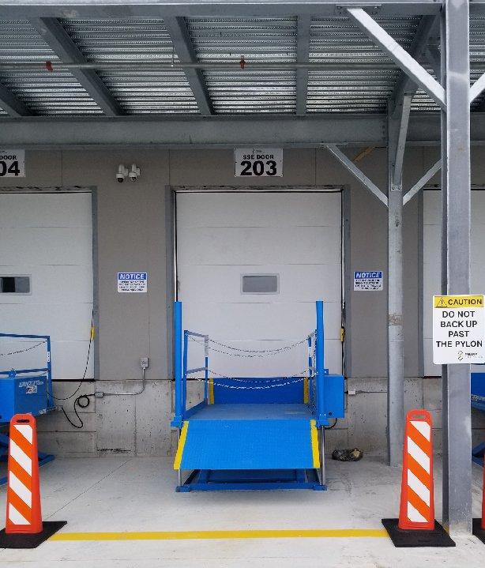
Trillium Caledon Agent Pickups: Dock Lift Table Safety
Reverse vehicle towards dock
Do not back up past pylons
Do not operate lift tables
Do not ride lift tables

